Slide 1
EKIN 5507
Exercise Prescription for Special Populations
HAPI Case Study | March 28, 2013
Courtney Jensen | Kinesiology

Slide 2
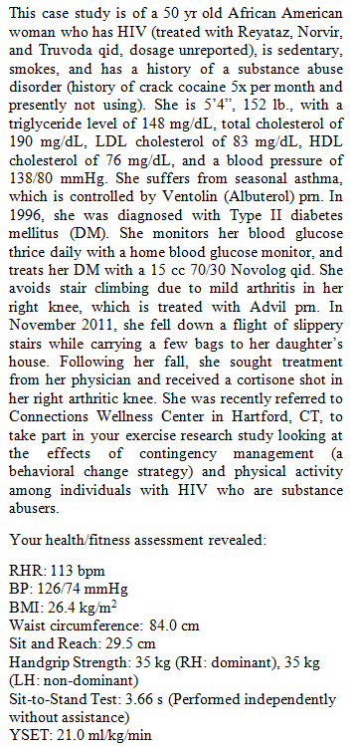
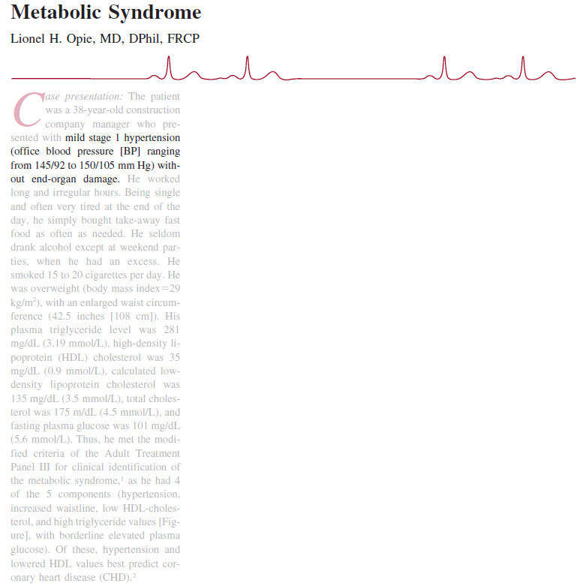
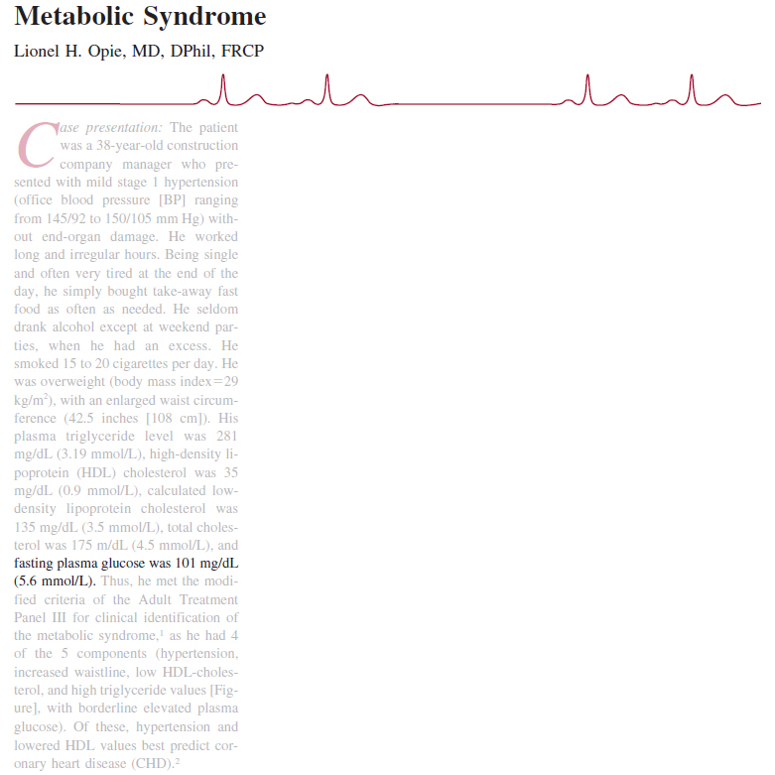
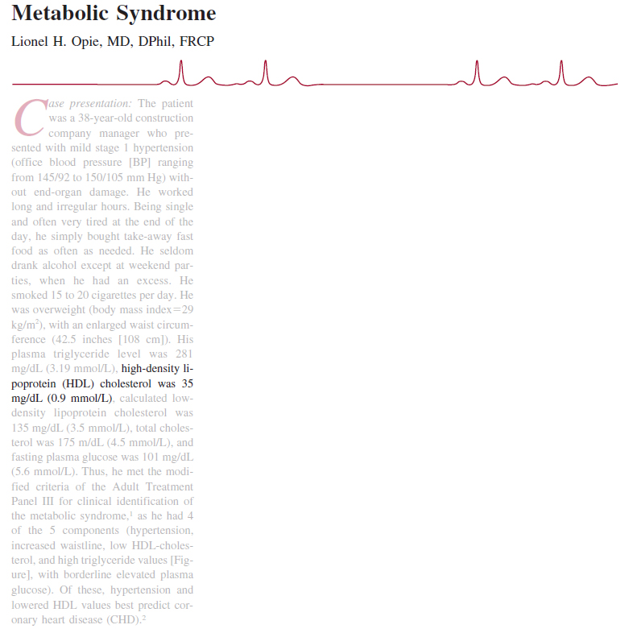
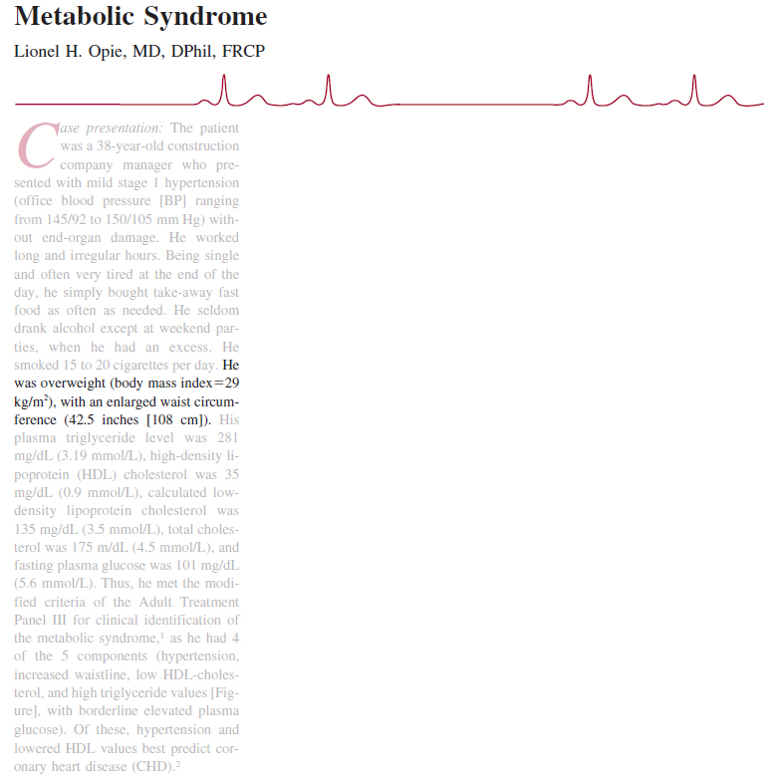
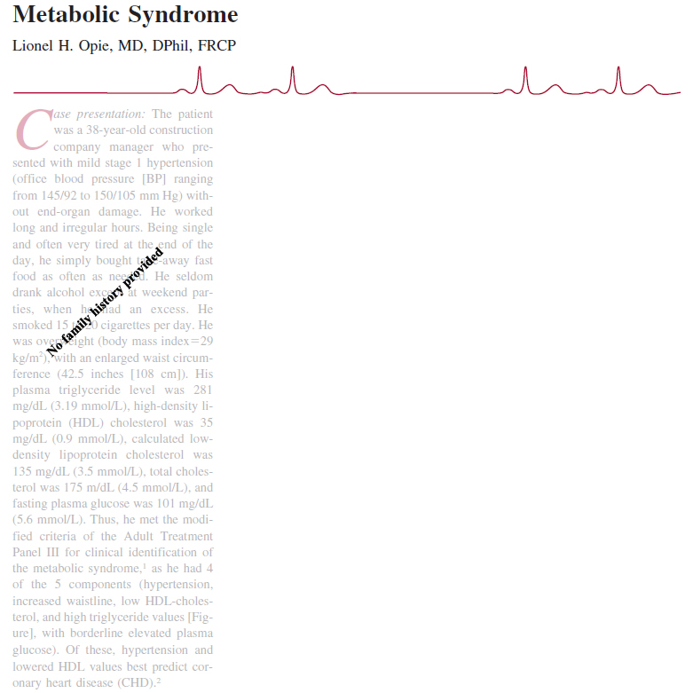
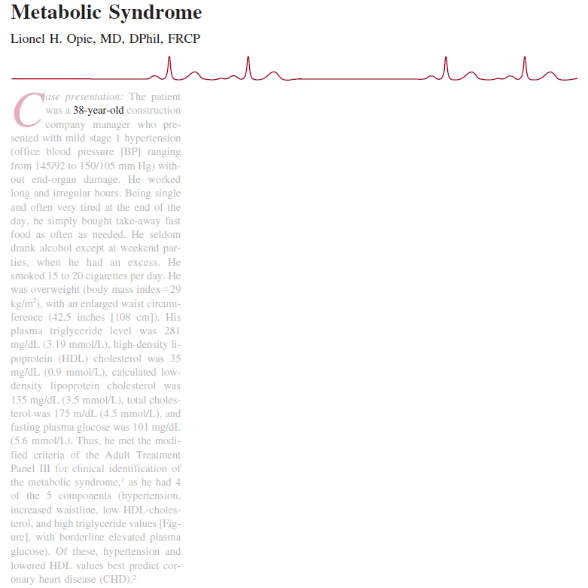
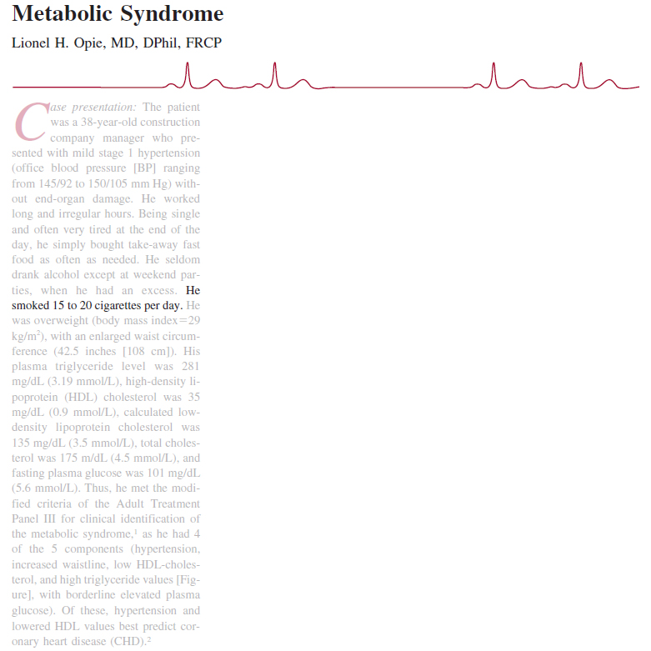
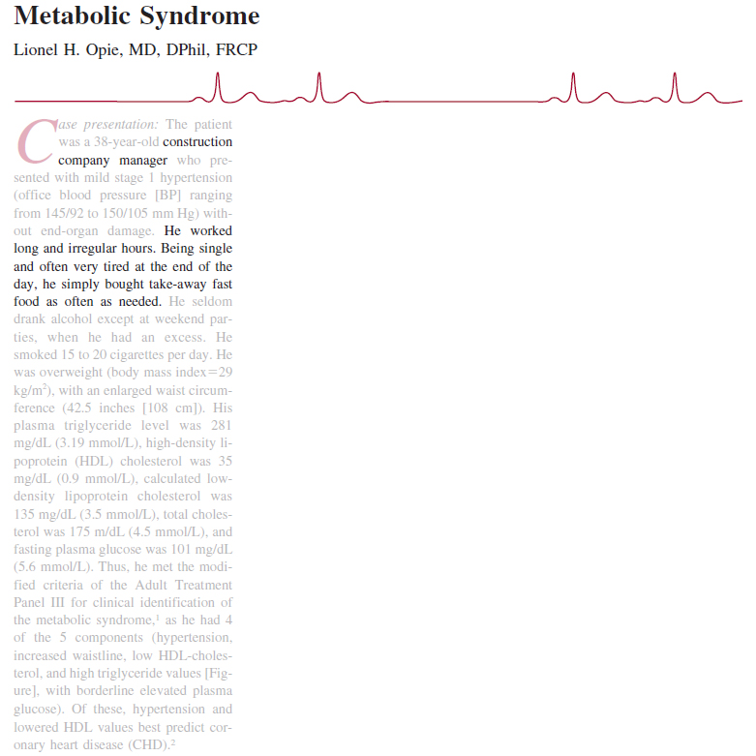
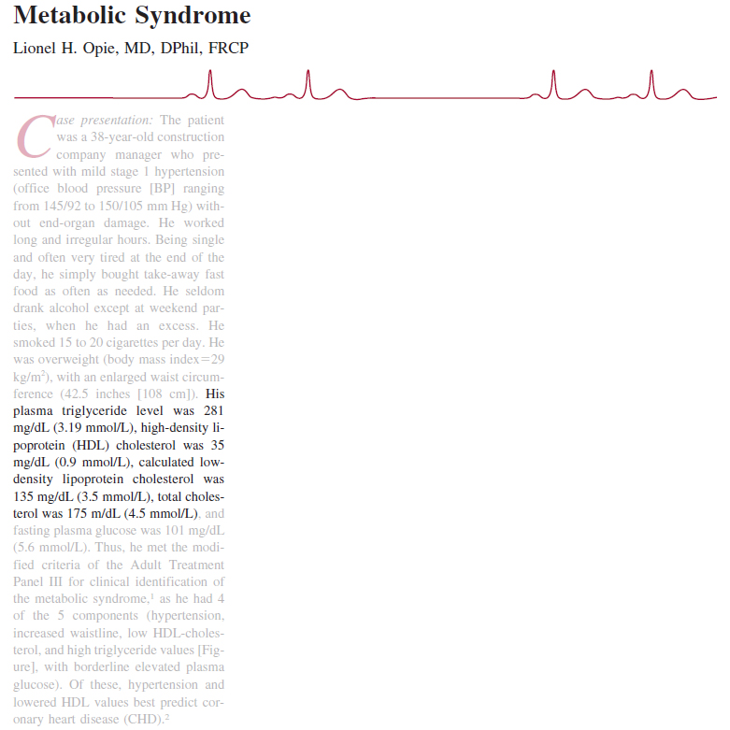

Slide 3
13. What exercises are recommended for this person? Why?

Slide 4
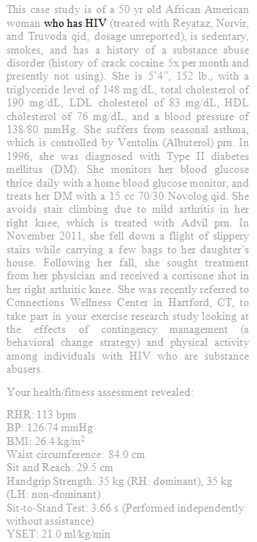
GETP9, pg. 293-295

Slide 5
Contact or otherwise high-risk activities (e.g., skateboarding) should be avoided due to risk of bleeding
GETP9, pg. 293-295

Slide 6
Contact or otherwise high-risk activities (e.g., skateboarding) should be avoided due to risk of bleeding
Osteopenia is common; if present, weight-bearing activities should be included
GETP9, pg. 293-295

Slide 7
Contact or otherwise high-risk activities (e.g., skateboarding) should be avoided due to risk of bleeding
Osteopenia is common; if present, weight-bearing activities should be included
Variability of health/capacity is often high, so choice of exercises might reflect day-to-day state more than chronic health
GETP9, pg. 293-295

Slide 8
Contact or otherwise high-risk activities (e.g., skateboarding) should be avoided due to risk of bleeding
Osteopenia is common; if present, weight-bearing activities should be included
Variability of health/capacity is often high, so choice of exercises might reflect day-to-day state more than chronic health
If asymptomatic, the ACSM Guidelines for healthy individuals should be used
GETP9, pg. 293-295

Slide 9
Contact or otherwise high-risk activities (e.g., skateboarding) should be avoided due to risk of bleeding
Osteopenia is common; if present, weight-bearing activities should be included
Variability of health/capacity is often high, so choice of exercises might reflect day-to-day state more than chronic health
If asymptomatic, the ACSM Guidelines for healthy individuals should be used
If symptomatic, the chosen exercises should enable supervision
GETP9, pg. 293-295

Slide 10
Contact or otherwise high-risk activities (e.g., skateboarding) should be avoided due to risk of bleeding
Osteopenia is common; if present, weight-bearing activities should be included
Variability of health/capacity is often high, so choice of exercises might reflect day-to-day state more than chronic health
If asymptomatic, the ACSM Guidelines for healthy individuals should be used
If symptomatic, the chosen exercises should enable supervision
Due to the increased prevalence of cardiovascular impairment/dysfunction, choice of exercise should enable appropriate periodic monitoring
GETP9, pg. 293-295

Slide 11
Contact or otherwise high-risk activities (e.g., skateboarding) should be avoided due to risk of bleeding
Osteopenia is common; if present, weight-bearing activities should be included
Variability of health/capacity is often high, so choice of exercises might reflect day-to-day state more than chronic health
If asymptomatic, the ACSM Guidelines for healthy individuals should be used
If symptomatic, the chosen exercises should enable supervision
Due to the increased prevalence of cardiovascular impairment/dysfunction, choice of exercise should enable appropriate periodic monitoring
There is a high incidence of peripheral neuropathy, which may require adjustments to be made to the type of exercises
GETP9, pg. 293-295

Slide 12
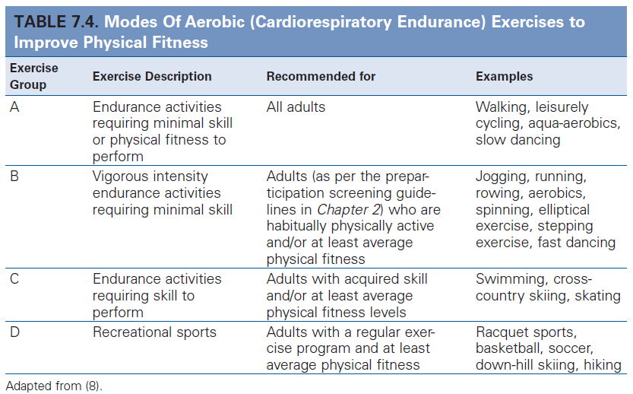
If asymptomatic, the ACSM Guidelines for healthy individuals should be used
GETP9, pg. 178, 182

Slide 13
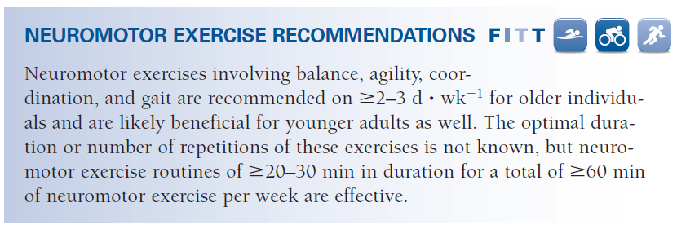
If asymptomatic, the ACSM Guidelines for healthy individuals should be used
GETP9, pg.188, 189

Slide 14
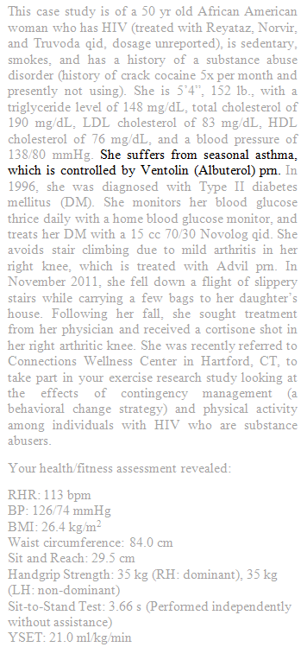
GETP9, pg. 331-334

Slide 15
Aerobic activities using large muscle groups (e.g., walking, running, cycling, and swimming) are suggested
GETP9, pg. 331-334

Slide 16
Aerobic activities using large muscle groups (e.g., walking, running, cycling, and swimming) are suggested
For resistance training and stretching, the ACSM Guidelines for healthy individuals should be used
GETP9, pg. 331-334

Slide 17
Aerobic activities using large muscle groups (e.g., walking, running, cycling, and swimming) are suggested
For resistance training and stretching, the ACSM Guidelines for healthy individuals should be used
Evidence supporting the efficacy of inspiratory muscle training is insufficient for inclusion
GETP9, pg. 331-334

Slide 18
Aerobic activities using large muscle groups (e.g., walking, running, cycling, and swimming) are suggested
For resistance training and stretching, the ACSM Guidelines for healthy individuals should be used
Evidence supporting the efficacy of inspiratory muscle training is insufficient for inclusion
Exercise type should reflect individual condition
If a particular mode exacerbates symptoms, the patient should not exercise until airway function improves
If a cold environment, pollutants, or airborne allergens induce symptoms, mode and location of exercise must consider these triggers
GETP9, pg. 331-334

Slide 19
Aerobic activities using large muscle groups (e.g., walking, running, cycling, and swimming) are suggested
For resistance training and stretching, the ACSM Guidelines for healthy individuals should be used
Evidence supporting the efficacy of inspiratory muscle training is insufficient for inclusion
Exercise type should reflect individual condition
If a particular mode exacerbates symptoms, the patient should not exercise until airway function improves
If a cold environment, pollutants, or airborne allergens induce symptoms, mode and location of exercise must consider these triggers
The Borg CR10 scale can be adapted to measure exertional dyspnea (Figure 9.1) in which 0 corresponds to no discomfort in breathing while 10 corresponds to severe discomfort
If casual outdoor walking is a 7 and moderate lap swimming is a 3, mode can reflect symptoms
GETP9, pg. 331-334

Slide 20
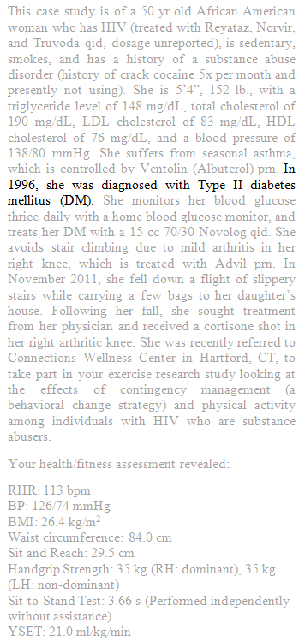
GETP9, pg. 278-284

Slide 21
Exercise should incorporate large muscle groups (used in a rhythmic fashion)
GETP9, pg. 278-284

Slide 22
Exercise should incorporate large muscle groups (used in a rhythmic fashion)
A combination of aerobic and resistance training protocols may improve blood glucose control better than either modality in isolation
GETP9, pg. 278-284

Slide 23
Exercise should incorporate large muscle groups (used in a rhythmic fashion)
A combination of aerobic and resistance training protocols may improve blood glucose control better than either modality in isolation
In the absence of contraindication, resistance training should be encouraged
GETP9, pg. 278-284

Slide 24
Exercise should incorporate large muscle groups (used in a rhythmic fashion)
A combination of aerobic and resistance training protocols may improve blood glucose control better than either modality in isolation
In the absence of contraindication, resistance training should be encouraged
The ACSM Guidelines for healthy individuals can generally apply
GETP9, pg. 278-284

Slide 25
Exercise should incorporate large muscle groups (used in a rhythmic fashion)
A combination of aerobic and resistance training protocols may improve blood glucose control better than either modality in isolation
In the absence of contraindication, resistance training should be encouraged
The ACSM Guidelines for healthy individuals can generally apply
Many patients present with comorbidities and appropriate tailoring may be necessary
GETP9, pg. 278-284

Slide 26
Exercise should incorporate large muscle groups (used in a rhythmic fashion)
A combination of aerobic and resistance training protocols may improve blood glucose control better than either modality in isolation
In the absence of contraindication, resistance training should be encouraged
The ACSM Guidelines for healthy individuals can generally apply
Many patients present with comorbidities and appropriate tailoring may be necessary
Thermoregulation is often impaired, so additional precautions may be warranted if exercising in hot or cold environments
GETP9, pg. 278-284

Slide 27
Different modes of exercise may affect glucose levels differently
GETP9, pg. 278-284

Slide 28
Different modes of exercise may affect glucose levels differently
Hypoglycemia is the most serious concern and can occur up to 12 h after exercise
GETP9, pg. 278-284

Slide 29
Different modes of exercise may affect glucose levels differently
Hypoglycemia is the most serious concern and can occur up to 12 h after exercise
To avoid it, monitor blood glucose during different modes (walking versus weight training for example) and be aware of symptoms (shakiness, weakness, abnormal sweating, anxiety, tingling sensations, and hunger)
GETP9, pg. 278-284

Slide 30
Different modes of exercise may affect glucose levels differently
Hypoglycemia is the most serious concern and can occur up to 12 h after exercise
To avoid it, monitor blood glucose during different modes (walking versus weight training for example) and be aware of symptoms (shakiness, weakness, abnormal sweating, anxiety, tingling sensations, and hunger)
Continuous glucose monitoring may be useful to detect patterns resulting from different exercise modalities
GETP9, pg. 278-284

Slide 31
Different modes of exercise may affect glucose levels differently
Hypoglycemia is the most serious concern and can occur up to 12 h after exercise
To avoid it, monitor blood glucose during different modes (walking versus weight training for example) and be aware of symptoms (shakiness, weakness, abnormal sweating, anxiety, tingling sensations, and hunger)
Continuous glucose monitoring may be useful to detect patterns resulting from different exercise modalities
Early on, the exercises chosen should be capable of being conducted with a partner or under supervision
GETP9, pg. 278-284

Slide 32
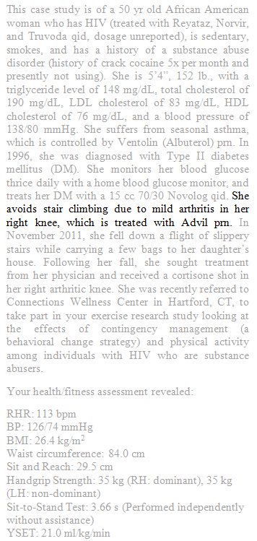
GETP9, pg. 261-263

Slide 33
Adequate warm-ups and cool-downs should be conducted in which joints are moved through their full range of motion
GETP9, pg. 261-263

Slide 34
Adequate warm-ups and cool-downs should be conducted in which joints are moved through their full range of motion
Aerobic activities to include: exercise with low stress to the joints (e.g., walking, cycling, swimming)
GETP9, pg. 261-263

Slide 35
Adequate warm-ups and cool-downs should be conducted in which joints are moved through their full range of motion
Aerobic activities to include: exercise with low stress to the joints (e.g., walking, cycling, swimming)
For water exercises, the water temperature should be 83° to 88° F as warmer water has muscle-relaxing and analgesic effects
GETP9, pg. 261-263

Slide 36
Adequate warm-ups and cool-downs should be conducted in which joints are moved through their full range of motion
Aerobic activities to include: exercise with low stress to the joints (e.g., walking, cycling, swimming)
For water exercises, the water temperature should be 83° to 88° F as warmer water has muscle-relaxing and analgesic effects
Some patients will be able to tolerate treadmill exercise, but cycle ergometry (or cycle ergometry combined with arm ergometry) may generate less discomfort
GETP9, pg. 261-263

Slide 37
Adequate warm-ups and cool-downs should be conducted in which joints are moved through their full range of motion
Aerobic activities to include: exercise with low stress to the joints (e.g., walking, cycling, swimming)
For water exercises, the water temperature should be 83° to 88° F as warmer water has muscle-relaxing and analgesic effects
Some patients will be able to tolerate treadmill exercise, but cycle ergometry (or cycle ergometry combined with arm ergometry) may generate less discomfort
If exercise includes walking or comparable movements, appropriate footwear (sufficient shock absorption and stability) is crucial
GETP9, pg. 261-263

Slide 38
Adequate warm-ups and cool-downs should be conducted in which joints are moved through their full range of motion
Aerobic activities to include: exercise with low stress to the joints (e.g., walking, cycling, swimming)
For water exercises, the water temperature should be 83° to 88° F as warmer water has muscle-relaxing and analgesic effects
Some patients will be able to tolerate treadmill exercise, but cycle ergometry (or cycle ergometry combined with arm ergometry) may generate less discomfort
If exercise includes walking or comparable movements, appropriate footwear (sufficient shock absorption and stability) is crucial
Aerobic activities to avoid: high impact activities (e.g., running, stair climbing) and those with stop-and-go components
GETP9, pg. 261-263

Slide 39
GETP9, pg. 261-263

Slide 40
Resistance exercise and flexibility training should include all major muscle groups, using the ACSM Guidelines for healthy individuals as a foundation
GETP9, pg. 261-263

Slide 41
Resistance exercise and flexibility training should include all major muscle groups, using the ACSM Guidelines for healthy individuals as a foundation
Neuromotor, balance, and other functional activities should be incorporated (e.g., sit-to-stand and step-ups) as can be tolerated in order to improve and maintain the ability to perform activities of daily living
GETP9, pg. 261-263

Slide 42
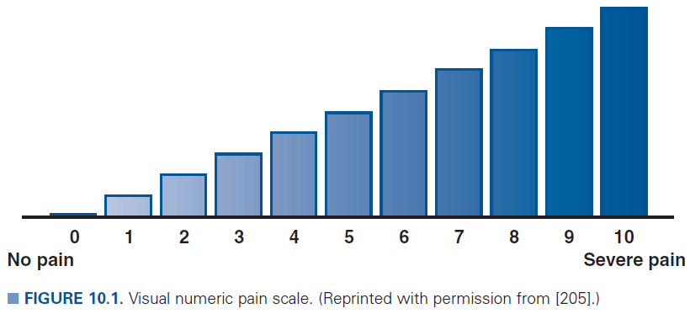
Pain is usually a major barrier to initiating and maintaining an exercise program, so the mode prescribed for each type of activity should be the least painful

Slide 43
Pain is usually a major barrier to initiating and maintaining an exercise program, so the mode prescribed for each type of activity should be the least painful
During acute inflammation, strenuous exercises should be postponed until the flare has subsided

Slide 44
Pain is usually a major barrier to initiating and maintaining an exercise program, so the mode prescribed for each type of activity should be the least painful
During acute inflammation, strenuous exercises should be postponed until the flare has subsided
Gentle alternative activities may still be performed during these times, focusing on moving joints through their full range of motion

Slide 45
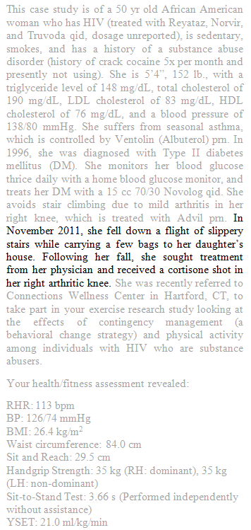
This particular patient may have more severe limitations in her arthritis, compounded by her injury
GETP9, pg. 261-263

Slide 46
This particular patient may have more severe limitations in her arthritis, compounded by her injury
More conservative interim goals may be appropriate in which she is encouraged to perform whichever physical activities she can without pain
GETP9, pg. 261-263

Slide 47
This particular patient may have more severe limitations in her arthritis, compounded by her injury
More conservative interim goals may be appropriate in which she is encouraged to perform whichever physical activities she can without pain
She should be informed that a small amount of discomfort in the working muscles/joints during and immediately she exercises is to be expected
GETP9, pg. 261-263

Slide 48
This particular patient may have more severe limitations in her arthritis, compounded by her injury
More conservative interim goals may be appropriate in which she is encouraged to perform whichever physical activities she can without pain
She should be informed that a small amount of discomfort in the working muscles/joints during and immediately she exercises is to be expected
However, if pain persists 2 h following, adjustments must be made in mode as well as other FITT components
GETP9, pg. 261-263

Slide 49
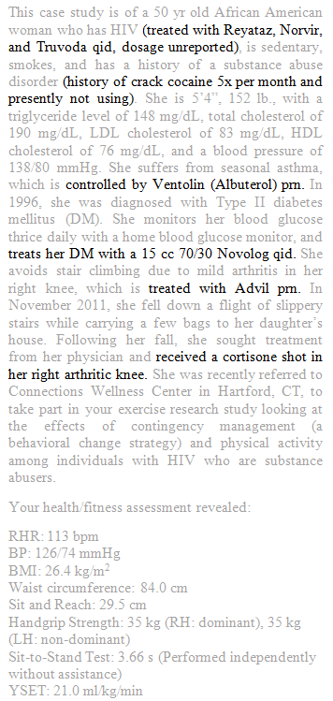
Antiretroviral medications
(Unlisted in GETP9 Appendix A)
Diarrhea (30%)
Headache (25%)
Abdominal pain (20% )
Nausea (20% )
Fatigue (9%)
Myalgia (5%)
Cardiovascular (e.g., atrioventricular block, right bundle branch block) and endocrine (e.g, hyperglycemia, diabetes) are serious but less common (typically occurring in fewer than 2% of patients)
Antiretroviral medications may affect day-to-day condition, exacerbating HIV-associated fluctuations in health
Exercise choices should reflect daily circumstances
Micromedex.com

Slide 50
Novolog | Rapid acting insulin
(Not present in GETP9 Table A.1.)
Hypoglycemia (27% to 75% )
Less common: lipodystrophy
Glucose and insulin dosage and timing should be monitored relative to different modes of exercise (e.g. resistance versus aerobic exercise) for up to 12 h after
GETP9, Appendix A
Micromedex.com

Slide 51
Cortisone | Corticosteroid
(Appendix A only contains inhaled corticosteroids)
Hypertension and gastrointestinal disorders are listed as a common side effect with no incidence listed
Osteoporosis and hyperglycemia are listed as serious side effects with no incidence
With a one-time dose, she’s unlikely to experience these side effects
If doses repeat, it may be prudent to monitor osteoporosis (due to common incidence with HIV), hyperglycemia (due to DM), and hypertension
GETP9, Appendix A
Micromedex.com

Slide 52
Albuterol | Beta-2 receptor agonist
Upper respiratory infection (21%)
Nausea (10% )
Headache (7% )
Tachyarrhythmia is common, but more serious cardiovascular side effects (e.g., atrial fibrillation,
myocardial infarction) are uncommon
Advil | NSAID
Heartburn (3% to 9% )
Nausea (3% to 9%)
Dizziness (3% to 9%)
Cardiovascular side effects (e.g., congestive heart failure, hypertension) occur in less than 1% of cases
GETP9, Appendix A
Micromedex.com

Slide 53
The patient’s bronchodilator may accelerate her HR, which can result in HR-based intensity measures overestimating her true intensity
Using a secondary measure such as a Borg scale may be appropriate
GETP9, Appendix A

Slide 54
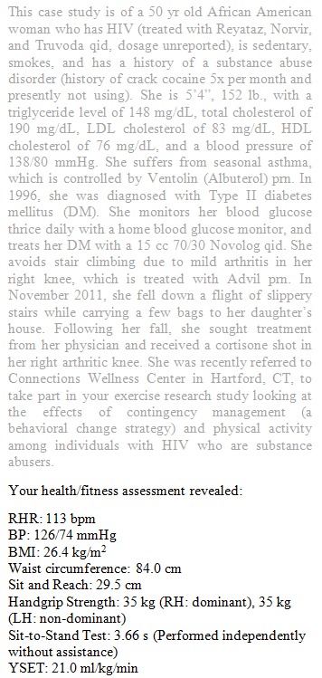

Slide 55
She is overweight
Similar to DM, exercise should incorporate large muscle groups
The primary mode of exercise recommended for weight loss is aerobic
She should be additionally cautious about impact activities exacerbating her arthritis
GETP9, chapter 10

Slide 56
She is overweight
Similar to DM, exercise should incorporate large muscle groups
The primary mode of exercise recommended for weight loss is aerobic
She should be additionally cautious about impact activities exacerbating her arthritis
She has prehypertension but a favorable lipid profile
Finding activities she’s likely to participate in frequently may be have a positive effect on her BP due to the accumulated episodes of postexercise hypotension, each lasting up to 24 hours
GETP9, chapter 10

Slide 57
She is overweight
Similar to DM, exercise should incorporate large muscle groups
The primary mode of exercise recommended for weight loss is aerobic
She should be additionally cautious about impact activities exacerbating her arthritis
She has prehypertension but a favorable lipid profile
Finding activities she’s likely to participate in frequently may be have a positive effect on her BP due to the accumulated episodes of postexercise hypotension, each lasting up to 24 hours
Her VO₂ and RHR suggest poor cardiopulmonary fitness
Exercise modes should reflect this, focusing on aerobic activity
GETP9, chapter 10

Slide 58
Her grip strength and floor transfer test suggest above average strength and physical functioning
Her sit-and-reach score suggests good flexibility
GETP9, chapter 10

Slide 59
In Summation, the choice of exercise should reflect interests of the individual
If her interests permit, the following would be advised:

Slide 60
In Summation, the choice of exercise should reflect interests of the individual
If her interests permit, the following would be advised:
Adequate warm-up and cool-down should be conducted

Slide 61
In Summation, the choice of exercise should reflect interests of the individual
If her interests permit, the following would be advised:
Adequate warm-up and cool-down should be conducted
Aerobic and resistance exercises in which large muscle groups are incorporated

Slide 62
In Summation, the choice of exercise should reflect interests of the individual
If her interests permit, the following would be advised:
Adequate warm-up and cool-down should be conducted
Aerobic and resistance exercises in which large muscle groups are incorporated
The resistance exercise should incorporate all major muscle groups (beneficial for numerous reasons, including DM and bone density)
Resources such as gym access will be a factor in determining what type of resistance exercises are performed

Slide 63
In Summation, the choice of exercise should reflect interests of the individual
If her interests permit, the following would be advised:
Adequate warm-up and cool-down should be conducted
Aerobic and resistance exercises in which large muscle groups are incorporated
The resistance exercise should incorporate all major muscle groups (beneficial for numerous reasons, including DM and bone density)
Resources such as gym access will be a factor in determining what type of resistance exercises are performed
Due her to poor cardiovascular fitness and her disease profile, aerobic exercise should be a major focus

Slide 64
In Summation, the choice of exercise should reflect interests of the individual
If her interests permit, the following would be advised:
Aerobic activities should be low-impact/low stress (walking, cycling, swimming in a warm pool) and avoid stop-and-go actions

Slide 65
In Summation, the choice of exercise should reflect interests of the individual
If her interests permit, the following would be advised:
Aerobic activities should be low-impact/low stress (walking, cycling, swimming in a warm pool) and avoid stop-and-go actions
May take a period of trial and error to figure out which exercises are safest

Slide 66
In Summation, the choice of exercise should reflect interests of the individual
If her interests permit, the following would be advised:
Aerobic activities should be low-impact/low stress (walking, cycling, swimming in a warm pool) and avoid stop-and-go actions
May take a period of trial and error to figure out which exercises are safest
In the event of a flare up, assess whether it’s the mode or the volume of the exercise that is inducing it

Slide 67
In Summation, the choice of exercise should reflect interests of the individual
If her interests permit, the following would be advised:
Aerobic activities should be low-impact/low stress (walking, cycling, swimming in a warm pool) and avoid stop-and-go actions
May take a period of trial and error to figure out which exercises are safest
In the event of a flare up, assess whether it’s the mode or the volume of the exercise that is inducing it
If there is a flare-up of arthritis, light activities can be performed in which joints are gently moved through the full range of motion

Slide 68
In Summation, the choice of exercise should reflect interests of the individual
If her interests permit, the following would be advised:
Aerobic activities should be low-impact/low stress (walking, cycling, swimming in a warm pool) and avoid stop-and-go actions
May take a period of trial and error to figure out which exercises are safest
In the event of a flare up, assess whether it’s the mode or the volume of the exercise that is inducing it
If there is a flare-up of arthritis, light activities can be performed in which joints are gently moved through the full range of motion
Floor transfer test suggests above average physical functioning, but neuromotor, balance, and other functional activities should be incorporated to maintain functionality

Slide 69
In Summation, the choice of exercise should reflect interests of the individual
If her interests permit, the following would be advised:
No exercises (aerobic, resistance, or functional) should incorporate actions that may dispose someone to bleeding (contact sports, etc.)

Slide 70
In Summation, the choice of exercise should reflect interests of the individual
If her interests permit, the following would be advised:
No exercises (aerobic, resistance, or functional) should incorporate actions that may dispose someone to bleeding (contact sports, etc.)
Choice of exercise modes should enable monitoring or exercise partners

Slide 71
In Summation, the choice of exercise should reflect interests of the individual
If her interests permit, the following would be advised:
No exercises (aerobic, resistance, or functional) should incorporate actions that may dispose someone to bleeding (contact sports, etc.)
Choice of exercise modes should enable monitoring or exercise partners
Her health and exercise capacity will vary due to her HIV and the prescription must reflect the day-today changes in her condition

Slide 72
In Summation, the choice of exercise should reflect interests of the individual
If her interests permit, the following would be advised:
No exercises (aerobic, resistance, or functional) should incorporate actions that may dispose someone to bleeding (contact sports, etc.)
Choice of exercise modes should enable monitoring or exercise partners
Her health and exercise capacity will vary due to her HIV and the prescription must reflect the day-today changes in her condition
Environments that might exacerbate seasonal asthma should be avoided

Slide 73
In Summation, the choice of exercise should reflect interests of the individual
If her interests permit, the following would be advised:
No exercises (aerobic, resistance, or functional) should incorporate actions that may dispose someone to bleeding (contact sports, etc.)
Choice of exercise modes should enable monitoring or exercise partners
Her health and exercise capacity will vary due to her HIV and the prescription must reflect the day-today changes in her condition
Environments that might exacerbate seasonal asthma should be avoided
Because the patient reports being sedentary, any activity that will get her moving (out of bed, out of the chair, perhaps out of the house) in order to break up long periods of activity will be beneficial.

